Slide 1

Lesson 7
Model Inheritance
View Inheritance

Slide 2
Model Inheritance

Slide 3









Default inheritance
class TestModel(models.Model):
_name = "test.model"
_description = "Test Model"
test.model inherits from the Model class
@api.model (/create_multi) def create(self, vals):
# Do some business logic, modify vals...
...
# Then call super to execute the parent method
return super().create(vals)
automatically gives the CRUD methods:
create()
read()
write()
unlink()
C
R
Update
Delete
def read(self, fields=None, load='_classic_read'): # Do some business logic
return super().read(fields, load)
def write(self, vals):
# Do some business logic
return super().write(vals)
def unlink(self, vals):
# Do some business logic
return super().unlink()
always call super()
always return data consistent in parent method.

Slide 4


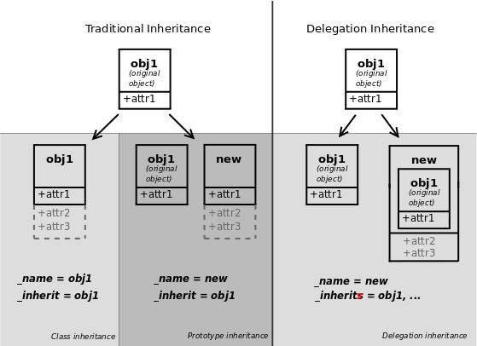





Model Inheritance
3 mechanisms to extend models
₁● Extending existing model
₂● Creating new model from existing one and add new information
₃● Delegating some of the model’s fields to records it contains
1
2
3
CLICK HERE

Slide 5



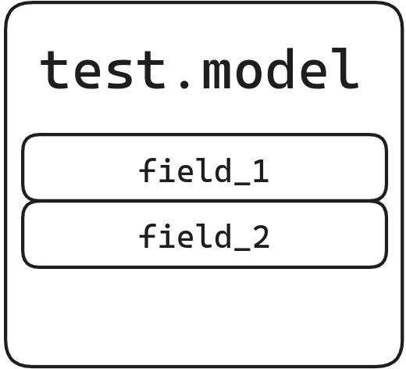

Class inheritance
Module A
from odoo import fields, models
class TestModel(models.Model):
_name = "test.model"
_description = "Test Model"
We have a simple model in a module
field_1 = fields.Char() field_2 = fields.Char()
CLICK HERE

Slide 6


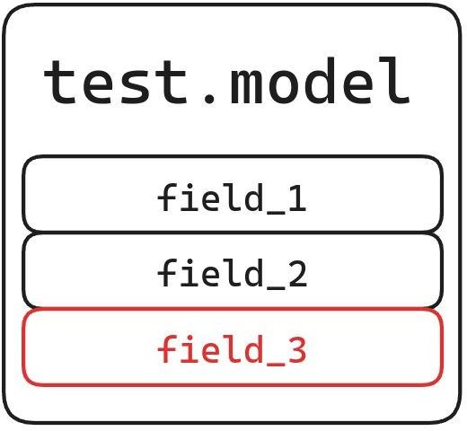

Class inheritance
Module A
from odoo import fields, models
Define a new class that extends an existing model
using _inherit
class TestModel(models.Model):
_name = "test.model"
_description = "Test Model"
field_1 = fields.Char() field_2 = fields.Char()
→ test.model will have properties defined in both classes
Module B
from odoo import fields, models
class TestModel(models.Model):
_inherit = "test.model"
field_3 = fields.Char()

Slide 7


Prototype inheritance
from odoo import fields, models
class TestModel(models.Model):
_name = "test.model"
_description = "Test Model"
We have a simple model in a module
field_1 = fields.Char() field_2 = fields.Char()
CLICK HERE

Slide 8

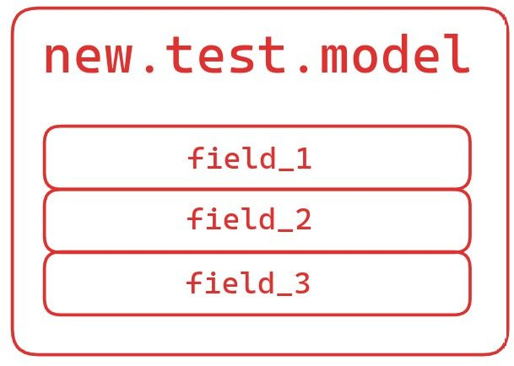

Prototype inheritance
from odoo import fields, models
class TestModel(models.Model):
_name = "test.model"
_description = "Test Model"
New model → extension of first model with both:
_name = …
_inherit = …
field_1 = fields.Char() field_2 = fields.Char()
New model
Possess first model functionality
( fields, methods and meta-information)
Can add its own functionality
class TestModel(models.Model):
_name = "new.test.model"
_inherit = "test.model"
field_3 = fields.Char()

Slide 9
View Inheritance

Slide 10






View Inheritance
<record id="MODEL_view_TYPE" model="ir.ui.view">
<field name="name">model.view.type</field>
<field name="model">model</field>
<field name="arch" type="xml">
<VIEW_TYPE>
<VIEW_SPECIFICATIONS/>
</VIEW_TYPE>
</field>
</record>
Define a New view
as seen in chapter 6
Extend an existing one
<record id="inherit_MODEL_view_TYPE" model="ir.ui.view">
<field name="name">model.view.type.inherit</field>
<field name="model">model</field>
new field used : inherid_id
<field name="inherit_id" ref="module.inherited_view_id"/>
<field name="arch" type="xml">
<xpath expr="..." position="...">
<!-- do the appropriate modification… -->
</xpath>
</field>
</record>
CLICK HERE

Slide 11




Elements modiﬁcation
expr: locating single element in parent view
position: action to do
<xpath expr="//field[@name='name']" position="after">
<!-- do the appropriate modification… -->
</xpath>
elements depending on position value
CLICK HERE

Slide 12





Xpath - expr
View to override
<form>
<sheet>
<div class="oe_button_box">
<BUTTONS/>
</div>
<group>
<group>
<field name="name"/>
</group>
</group>
<notebook>
<page string="Page1">
<group>
<CONTENT/>
</group>
</page>
<page string="Page2">
<group>
<CONTENT/>
</group>
</page>
</notebook>
</sheet>
</form>
Locating a node on the view we are inheriting
<xpath expr="//div[hasclass('oe_button_box')" position="...">
<!-- finds the first div element using a class 'oe_button_box' … -->
</xpath>
<xpath expr="//field[@name='name']" position="...">
<!-- finds the first field tax anywhere with name: 'name' … -->
</xpath>
CLICK HERE

Slide 13






Xpath - position
Keys
before after inside
<xpath expr="..." position="KEY">
<!-- BODY used based on the position value –->
<group>
<field name="new_field_1"/>
</group>
<group>
<field name="new_field_2"/>
</group>
</xpath>
- inserts BODY before the matched element
- inserts BODY after the matched element
- appends BODY to the end of the matched element
replace - replaces the matched element with BODY
CLICK HERE

Slide 14



Xpath - position - attributes
<xpath expr="..." position="attributes">
<attribute name="invisible">0</attribute>
<attribute name="required">1</attribute>
<attribute name="readonly">0</attribute>
attributes
- alters the attributes of the matched element using the BODY’s elements
</xpath>
CLICK HERE

Slide 15
Exercise
Lesson 7
CRUDS
Add business logic to the CRUD methods.
Prevent deletion of a property if its state is not ‘New’ or ‘Canceled’
Tip: create a new method with the ondelete() decorator and remember that self
can be a recordset with more than one record.
At offer creation, set the property state to ‘Offer Received’. Also raise an error if the user tries to create an offer with a lower amount than an existing offer.
Tip: The property_id field is available in the vals, but it is an int.
To instantiate an estate.property object,
use self.env[model_name].browse(value)
CLICK HERE

Slide 16
Exercise
Add a field to Users (res.users model)
Add the following field to the existing model:
Lesson 7
CRUDS
Class inheritance
Field
Type
property_ids
One2many inverse of the field that references the salesperson in estate.property
Add a domain to the field so it only displays the available
properties.

Slide 17
Exercise
Lesson 7
CRUDS
Class inheritance
Prototype inheritance
Add chatter into existing estate.property model.
Hint: you might look for mail.thread and mail.activity.mixin
and check in code to add in form view for class="oe_chatter"

Slide 18
Exercise
Lesson 7
CRUDS
Class inheritance
Prototype inheritance
View inheritance
Add new fields to the Users view.
Override the base.view_users_form to add the
property_ids field in a new notebook page.

